Slide 1
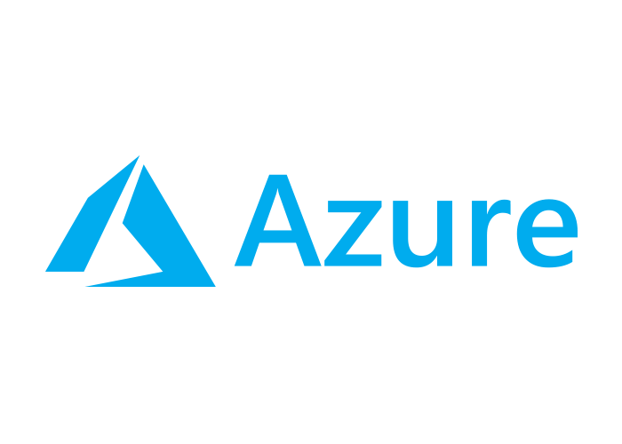

Using Azure to Create Cloud-Enabled Mobile Apps
Matthew Leibowitz
Software Engineer @ Microsoft
@mattleibow
maleib@microsoft.com

Slide 2

Software drives more of the things we do every day.
Notes:
Every day more and more of the things that we do are completely being driven by software.
From sending an email, to ordering a pizza, to driving our cars, software is there and we need to be able to reach them.

Slide 3
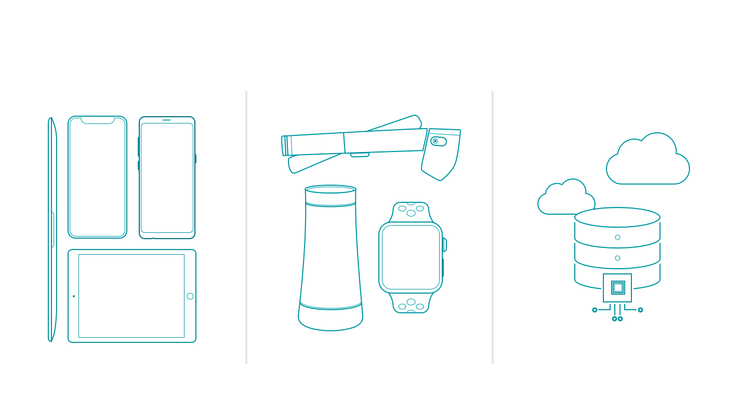
New challenges
More devices
Emerging platforms
Data & intelligence
Notes:
Additionally, there are more devices, platforms, and extensions into the world of AI and machine learning.
That is where Xamarin can help .NET developers.

Slide 4







Your platform for building anything
Desktop
Web
Cloud
Mobile
Gaming
IoT
AI
.NET
Notes:
So that is how Xamarin as part of the .NET platform enables you to reach even more platforms than ever and share code between all of your apps.

Slide 5
App Development With Xamarin
Notes:
So, let’s get into how we build apps with Xamarin.

Slide 6
An open source app platform
from Microsoft for
building modern & performant
iOS, Android, macOS,
watchOS, & tvOS apps with .NET.
Notes:
This is similar to .NET core, which is: an open source software platform
from Microsoft for
building modern & performant
Windows, macOS & Linux
apps and websites with .NET

Slide 7
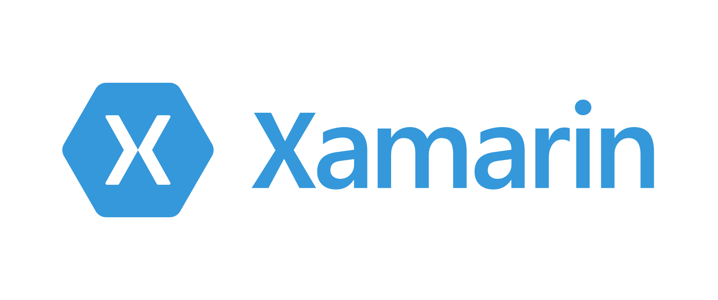




Productive environment
Maximize code reuse
Native performance & integrations
Expansive ecosystem
Notes:
Xamarin has a goal of delivering on these for core principals.
Each of them are exactly what developers need to be super productive.
Let’s walk through how Xamarin does this.

Slide 8

Xamarin App Architecture
.NET
C#
C#
C#
Shared C#
Business Logic • Platform APIs • User Interface
Shared C# codebase • 100% native API access • High performance
Notes:
Due to the nature of Xamarin, which is actually just an extension of .NET, we get to decide what platforms our apps can run on.
You can access all of the native APIs for each and share a bulk of the C# logic.
Here we see business logic, platform APIs, and user interfaces.
This can scale to a lot or a little based on what you are trying to achieve. So how exactly does this work?

Slide 9
Windows APIs
Windows.Media
Windows.Networking
Windows.Storage
Windows.Foundation
Windows.Devices
System.Net
System
System.IO
System.Linq
System.Xml
System.Data
System.Windows
System.Numerics
System.Core
System.ServiceModel
C#
Notes:
With .NET and Window development we always had the .NET Framework which offers tons of APIs for developers to use. When you want to target desktop or web, you download a SDK and get platform APIs.

Slide 10
Xamarin.iOS
MapKit
UIKit
SiriKit
ARKit
CoreML
System.Net
System
System.IO
System.Linq
System.Xml
System.Data
System.Windows
System.Numerics
System.Core
System.ServiceModel
C#
Notes:
What the Xamarin platform does for iOS, Android, macOS, watchOS, and tvOS is bring .NET directly to them and the platform delivers “C# bindings” around the native APIs. So you have access to everything, directly in C#.
Here we see just a few of the thousands of APIs available for iOS

Slide 11
Xamarin.Android
Fingerprint
Bluetooth
Picture-in-Picture
Geolocation
NFC
System.Net
System
System.IO
System.Linq
System.Xml
System.Data
System.Windows
System.Numerics
System.Core
System.ServiceModel
C#
Notes:
The same is true for Android with thousands of APIs beyond these. In addition, the Xamarin platform delivers essential integrations which we will talk about such as Google Play services and the support libraries.

Slide 12











.NET – A unified platform
TOOLS
DESKTOP
WEB
CLOUD
MOBILE
GAMING
IoT
AI
VISUAL STUDIO
.NET
VISUAL STUDIO FOR MAC
LIBRARIES
VISUAL STUDIO CODE
INFRASTRUCTURE
RUNTIME COMPONENTS
COMPILERS
LANGUAGES
COMMAND LINE INTERFACE
Notes:
Just like we saw earlier .NET is a platform to target everything, it is also a unified platform enabling you to share your libraries across all of the different platforms that you want to target. You can also build your apps with several different tools.

Slide 13


Steeltoe
.NET Core
Microsoft Web Protection Library
MSBuild
DotNetNuke
ASP.NET AJAX Control Toolkit
ASP.NET Core
SourceLink
Microsoft Azure WebJobs SDK
Salesforce Toolkits for .NET
nUnit
MVVM Light Toolkit
IronPython
Mailkit
WorldWide Telescope
Nancy
Open XML SDK
.NET SDK for Hadoop
MvvmCross
MEF
Mimekit
xUnit
ASP.NET Web Pages
NuGet
IdentityManager
Couchbase Lite for .NET
iOS
macOS
Entity Framework
.NET ECOSYSTEM
WCF
ILMerge
Xamarin.Mobile
ASP.NET SignalR
.NET Micro Framework
Open Live Writer
Mono
Xamarin.Auth
Xamarin SDK
Orchard CMS
OWIN Authentication Middleware
ProtoBuild
IdentityServer
Microsoft Azure SDK for .NET
.NET Compiler Platform ("Roslyn")
Prism
ASP.NET Web API
Cake
Orleans
Kudu
Cecil
LLILC
Umbraco
System.Drawing
ASP.NET MVC
Notes:
A core foundation of .NET is the .NET Foundation that is run by the .NET community and supports .NET projects and the community.

Slide 14
Under the Hood
Notes:
Now that we know how Xamarin fits into .NET, let’s take a look at the technology that is powering these apps.

Slide 15
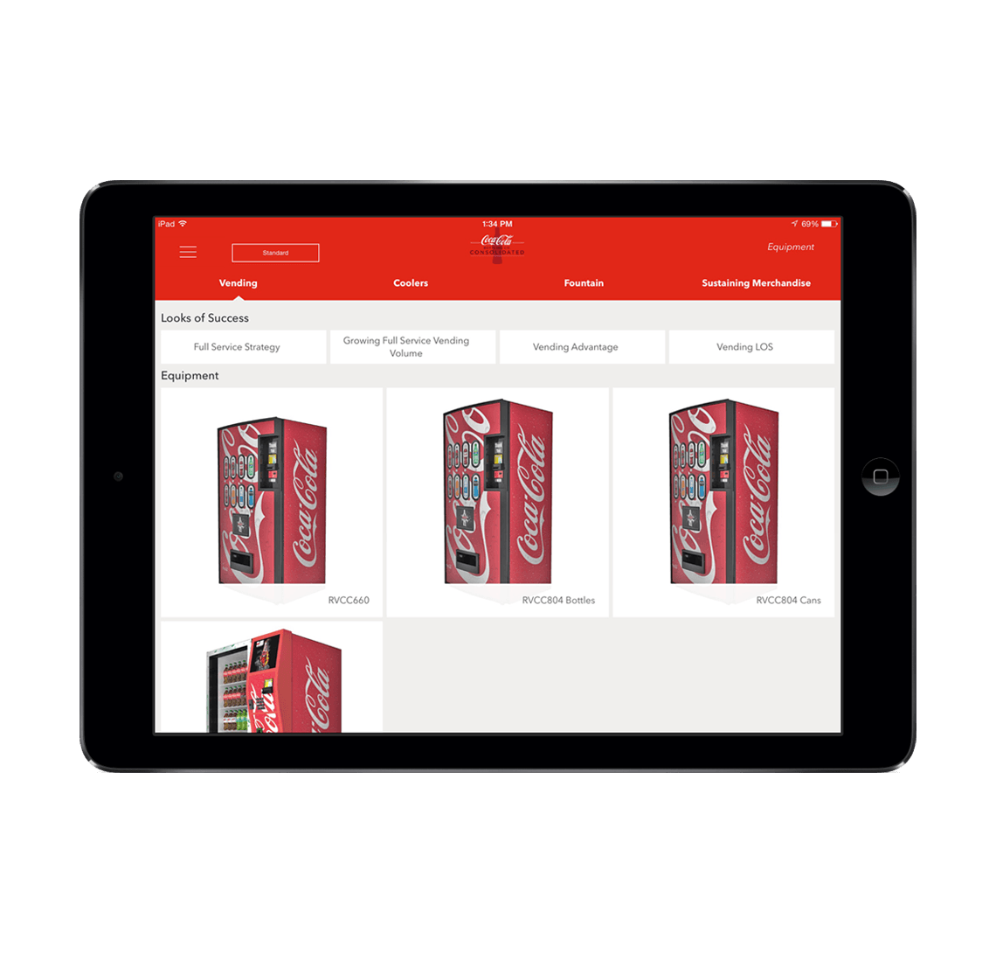



Non-Xamarin Apps
.NET
C#
F#
Visual Basic
Objective-C
Swift
Java
Kotlin
Xcode
Android Studio
Visual Studio

Slide 16
Xamarin App Architecture
.NET
C#
C#
C#
Shared C#
Business Logic
Notes:
First is the core architecture which enables huge amount of code sharing across apps. You can build stunning applications with high fidelity. Let’s talk about what is in each of these blocks, first with the head projects, platform APIs, and user interface. The business logic is just .NET code that can always be shared with other .NET platforms.

Slide 17

Xamarin.Essentials
Secure Settings
Sms
Preferences
Flashlight
Clipboard
Gyroscope
Magnetometer
Geolocation
Phone Dialer
Device Display Info
Email
Device Info
Battery
Compass
Accelerometer
Screen Lock
Data Transfer
Text to Speech
Geocoding
File System
Connectivity
Vibration
aka.ms/xamarinessentials
Notes:
Which is Xamarin.Essentials. An open source library that abstracts common native features into a single cross platform API for iOS, Android, and Windows. These are APIs that exist across each platform so why not bring them together.

Slide 18
Xamarin.Essentials: Cross-Platform Native APIs
.NET
C#
C#
C#
Xamarin.Essentials - Platform
Shared C#
Business Logic
Notes:
So now, if we look a bit further, this is what our app architecture looks like.

Slide 19

Xamarin.Forms
Notes:
What about the user interface? Just like APIs you can build the native UI for each platform. However, many developers choose to share all or most of the UI with Xamarin.Forms

Slide 20
Xamarin.Forms: Cross-Platform Native UI
.NET
C#
C#
C#
Xamarin.Forms - UI
Xamarin.Essentials - Platform
Shared C#
Business Logic
Notes:
We will look more at Xamarin.Forms, but now we can see a full picture of what goes into our app.

Slide 21
Code Sharing
On average Xamarin developers share
80% of code
across mobile apps.
Notes:
Regardless of app approaches and if you need to mix in native APIs or UI in addition to Xamarin.Essentials and Xamarin.Forms, the average app shares nearly 80% of code.

Slide 23




Essentials for mobile success
Beautiful native apps
Build, test, distribute, learn
Intelligent cloud

Slide 24










.NET cloud apps run best in Azure
Azure Storage
Azure Cosmos DB
Azure App Service
Azure Functions
Azure App Insights
Azure Service Fabric
Azure SignalR Service
Azure Virtual Machines
Azure SQL Database
Azure Cognitive Services
Azure Kubernetes Service (AKS)
And many more…
Extend apps with serverless, event driven tasks
Commoditized AI
Fully managed platform perfect for running .NET Framework and .NET Core web apps and services
Application performance and usability monitoring
Build native .NET, fully managed, scalable microservices
Relational Database
Non-Relational Database
Fully managed real-time web functions, like chat, gaming, tickers, collaboration and more
Store anything. Great for binaries
Container orchestrator for Linux workloads (.NET Core)
Notes:
No matter what you may need, there is a service in Azure for you. From serverless compute with Functions to realtime communication with SignalR, or databases with SQL and Cosmos DB there are great cross-platform SDKs for .NET.

Slide 25
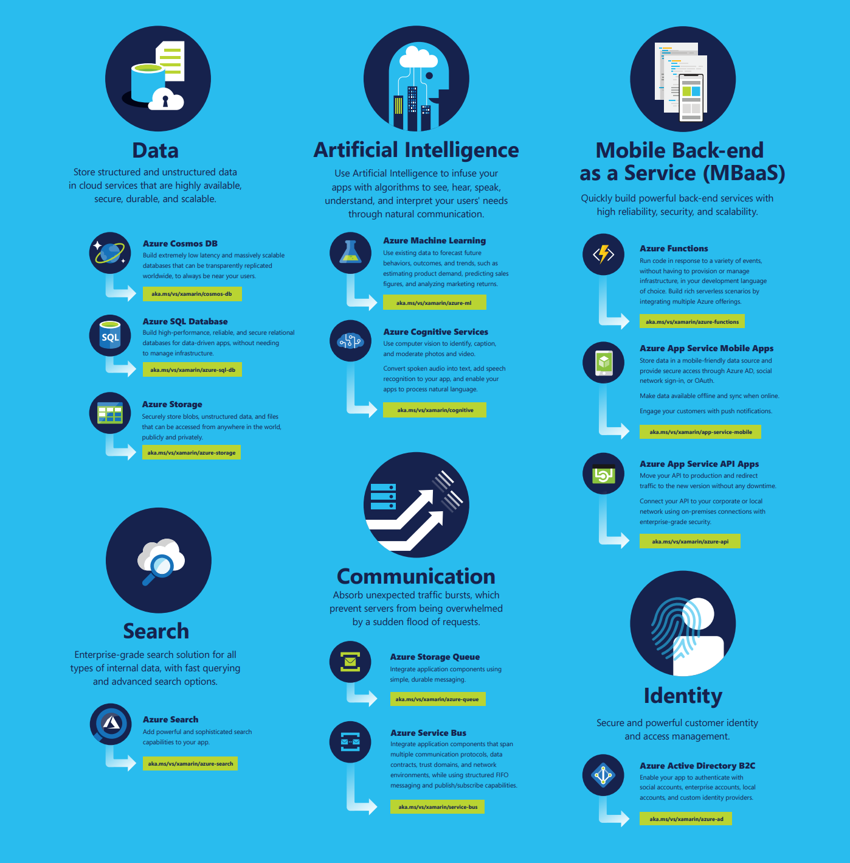

Slide 31

Authentication

Slide 32

Azure Active Directory
Seamless, secure identity, and access management
Multi-factor Auth
Cross-platform SDK

Slide 33

Azure Active Directory B2C
Use social, email, and custom IdPs
Customizable white label solution
Multi-Factor Authentication
Cross-platform SDK

Slide 34
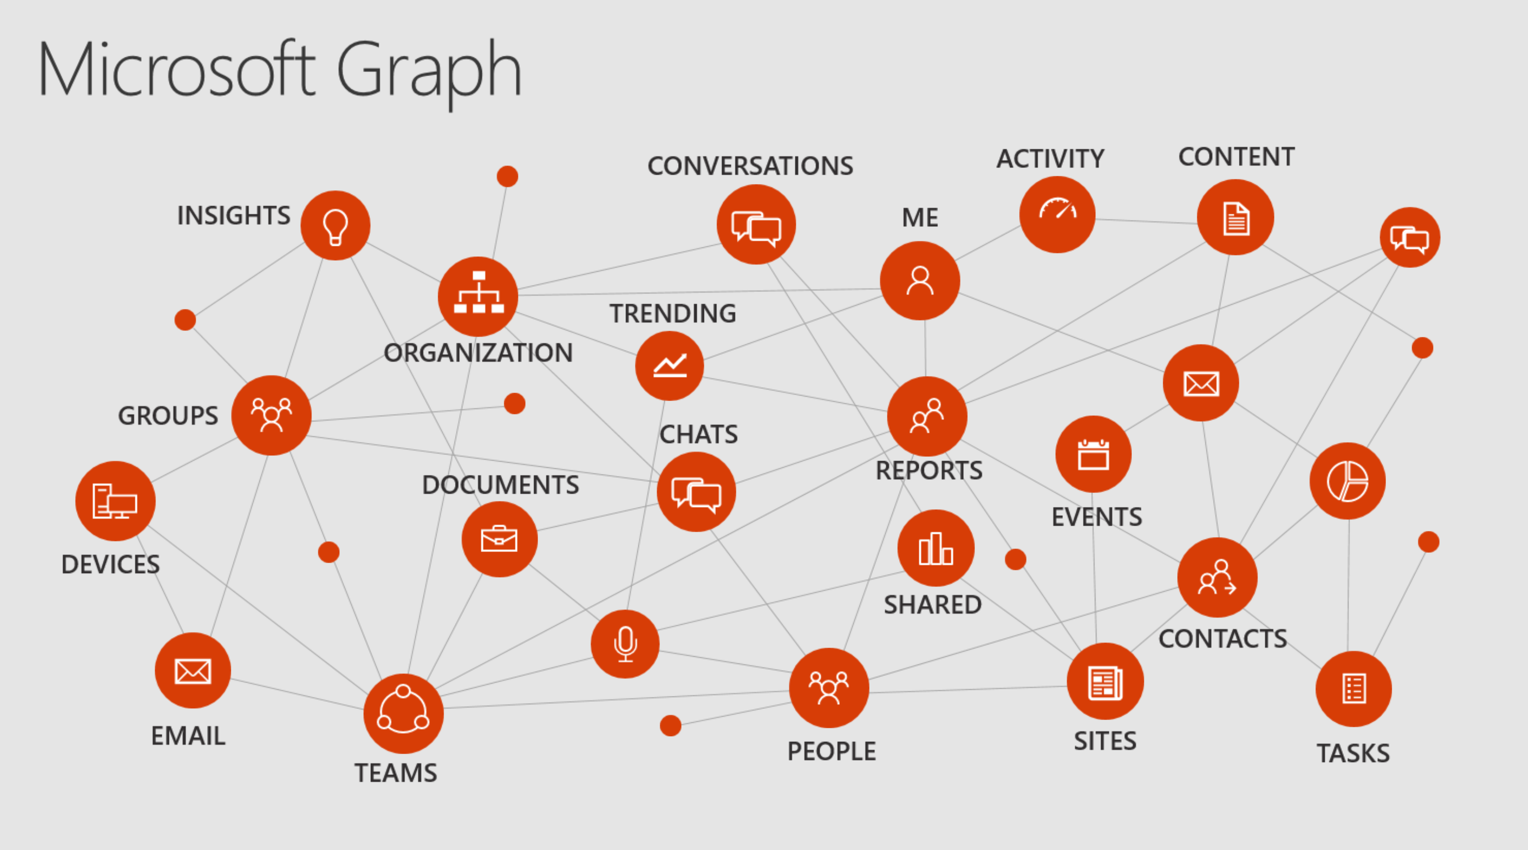

Slide 35

Data

Slide 36

Azure Cosmos DB
The first globally distributed, multi-model database service

Slide 37

Azure Cosmos DB
Globally distributed database service

Slide 38

Azure Cosmos DB
Scale to any need
Gigabytes of data
Petabytes of data
Hundreds transactions / second
Millions of transactions / second

Slide 39
Azure Cosmos DB
Only database with comprehensive SLAs across 4 dimensions
Microsoft Azure
High Availability
Performance Latency
Performance Throughput
Data Consistency

Slide 40
Azure Cosmos DB APIs
MongoDB
DocumentDB
Table storage
Gremlin Graph
Spark
Cassandra

Slide 41

Intelligent Apps

Slide 42





Azure SQL Data Warehouse
Azure Cosmos DB
Azure SQL DB
Data-driven Intelligence
Azure Machine Learning
Azure Cognitive Services
Azure Bot Service

Slide 43
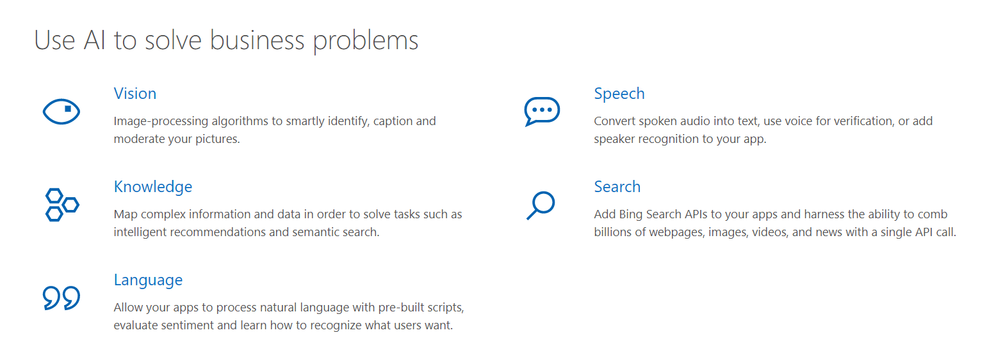
Cognitive Services

Slide 44

Serverless

Slide 45

Azure Functions
Event-driven compute
Scale on demand
Pay only for what you consume
Develop & Debug Locally
Great for mobile apps!

Slide 46
Your platform for building anything
Desktop
Web
Cloud
Mobile
Gaming
IoT
AI
.NET
Notes:
So that is how Xamarin as part of the .NET platform enables you to reach even more platforms than ever and share code between all of your apps.

Slide 47
Thank you.
Matthew Leibowitz
Software Engineer @ Microsoft
maleib@microsoft.com
dotnetdevaddict.co.za
@mattleibow

